Slide 1
Chapter 8
Introduction to
Responsive Web Design

Slide 2
Objectives
Applied
Given an HTML document for the desktop that uses a fixed layout, convert it so it uses fluid widths, scalable images, and fonts that are inherited by child elements.
Given an HTML document for the desktop that uses a fluid layout, add media queries that change the appearance of the page depending on the size of the screen where it’s displayed.
Given an HTML document with a navigation menu that uses media queries, use the SlickNav plugin to replace the navigation menu on smaller screen sizes.
Use the browser developer tools to test your responsive designs.
Knowledge
Describe the three components of a Responsive Web Design.
Describe three basic ways that you can test a responsive design.

Slide 3
Objectives (cont.)
Explain how fluid layouts compare to fixed layouts.
Explain why you should use relative font sizes with a responsive design.
Describe the use of the meta element for setting the viewport on mobile devices.
Describe the basic syntax of a media query.
Describe two standard approaches for developing the media queries for a responsive design.
Explain why you might want to use a SlickNav menu when developing a responsive design.

Slide 4
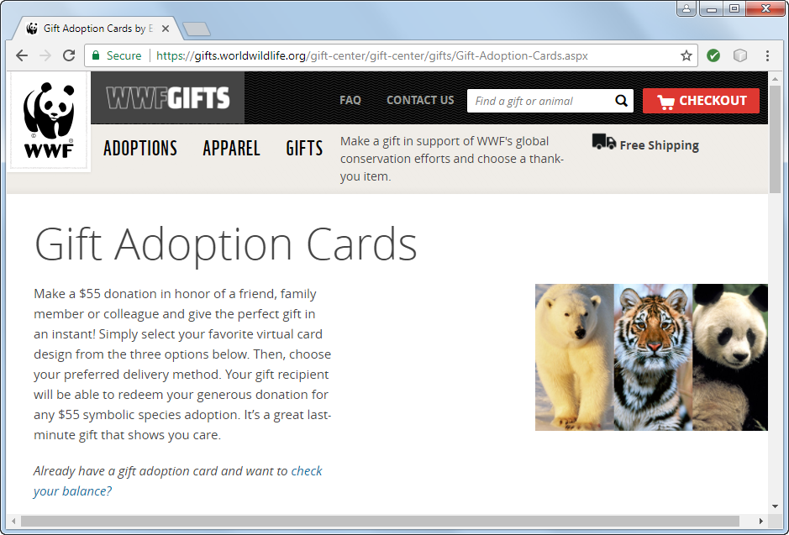
A website that uses RWD: Desktop

Slide 5
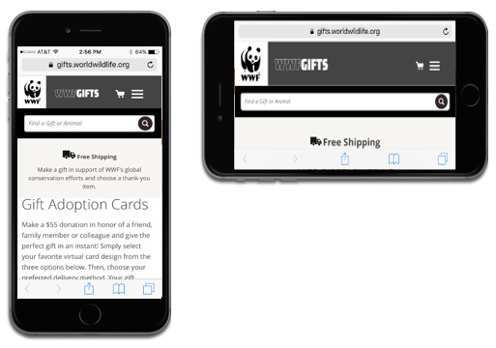
A website that uses RWD: Mobile

Slide 6
The three components of Responsive Web Design
Fluid layout
Media queries
Scalable images

Slide 7
Three ways to test a responsive design
Deploy your website to a server and then test it on each device.
Use device emulators and browser simulators for the various devices and browsers you want to test.
Use the developer tools provided by most modern browsers.

Slide 8
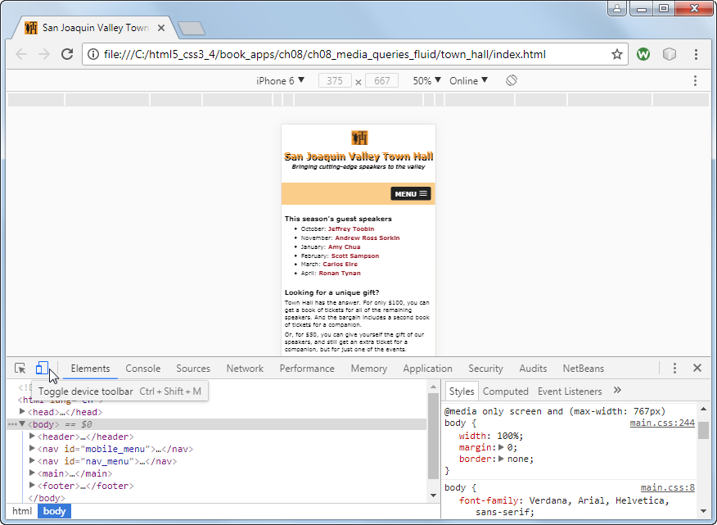
A web page in Chrome’s developer tools

Slide 9
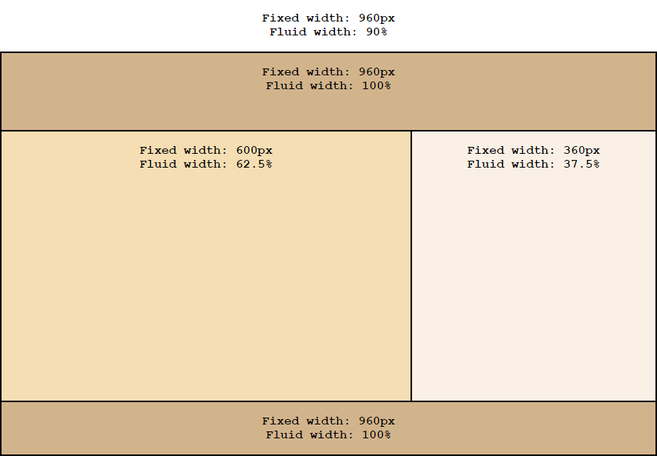
Fixed and fluid widths in a two-column layout

Slide 10
The benefits of fluid layouts
Page layouts are proportional to the size of the screen, so they will fill the screen equally at all sizes.
They are scalable, so when new screen sizes become available in the future, they will automatically adapt to those new sizes.
They can be used without media queries in some cases, although that’s not common.

Slide 11
A formula for converting pixels to percents
target ÷ context x 100 = result
The HTML for a page with padding and borders
<body>
<header><p>This is the text for the header.</p>
</header>
<main><p>This is the text for the main element.</p>
</main>
<aside><p>This is the text for the aside.</p>
</aside>
<footer><p>This is the text for the footer.</p>
</footer>
</body>

Slide 12
The CSS for a fluid layout
body {
width: 90%; /* changed from 960px */
max-width: 1024px; /* maximum width of page */
margin: 0 auto;
border: 2px solid black; }
header {
width: 96.875%; /* 930 ÷ 960 x 100 */
padding: 15px 1.5625%; /* 15 ÷ 960 x 100 */
border-bottom: 2px solid black; }
main {
width: 59.375%; /* 570 ÷ 960 x 100 */
padding: 15px 1.5625%; /* 15 ÷ 960 x 100 */
float: left; }
aside {
width: 34.375%; /* 330 ÷ 960 x 100 */
padding: 15px 1.5625%; /* 15 ÷ 960 x 100 */
float: right; }
footer {
clear: both;
width: 96.875%; /* 930 ÷ 960 x 100 */
padding: 15px 1.5625%; /* 15 ÷ 960 x 100 */
border-top: 2px solid black; }

Slide 13
Relative units of measure for responsive design
vh
vw
vmin
wmax

Slide 14
The HTML for a simple page
<body>
<header>
<h1>San Joaquin Valley Town Hall</h1>
</header>
<main>
<p>Welcome to San Joaquin Valley Town Hall. We
have some fascinating
speakers for you this season!</p>
</main>
</body>
CSS that sets the width of the body based on the width of the viewport
body {
width: 95vw;
margin: 0 auto; }

Slide 15
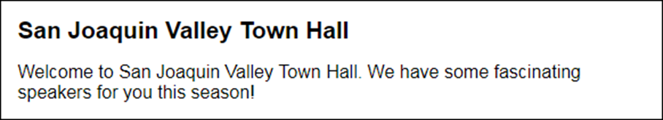
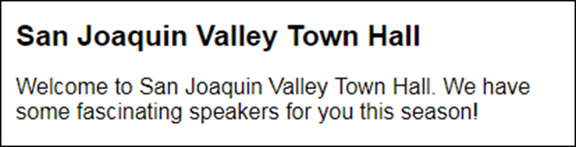
The page when the viewport is 580 pixels wide
The page when the viewport is 412 pixels wide

Slide 16

CSS that sets the width based on the minimum dimension of the viewport
body {
width: 95vmin;
margin: 0 auto; }
The page when the viewport is 580 pixels wide and 180 pixels tall

Slide 17
The HTML for a page with different font sizes
<body>
<header><h2>San Joaquin Valley Town Hall</h2>
</header>
<main>
<h1>This season's guest speakers</h1>
<ul>
<li>...</li>
<li>...</li>
<li>...</li>
</ul>
<p>Please contact us for tickets.</p>
</main>
<aside>
<h3>Lecture day, time, and location</h3>
<p>...</p>
</aside>
<footer>
<p>&copy; Copyright 2018 San Joaquin Valley Town
Hall.</p>
</footer>
</body>

Slide 18
CSS that specifies the font sizes in ems
body {
font-size: 100%; /* 16 pixels */
width: 90%;
max-width: 1024px;
margin: 0 auto;
border: 2px solid black; }
h1 { font-size: 1.75em; } /* 28 ÷ 16 */
h2 { font-size: 1.5em; } /* 24 ÷ 16 */
h3 { font-size: 1.125em; } /* 18 ÷ 16 */
footer p { font-size: .75em; } /* 12 ÷ 16 */
How to calculate the font size in ems
Divide the font size in pixels by 16.
How to calculate the font size as a percent
Multiply the result of the calculation above by 100.

Slide 19
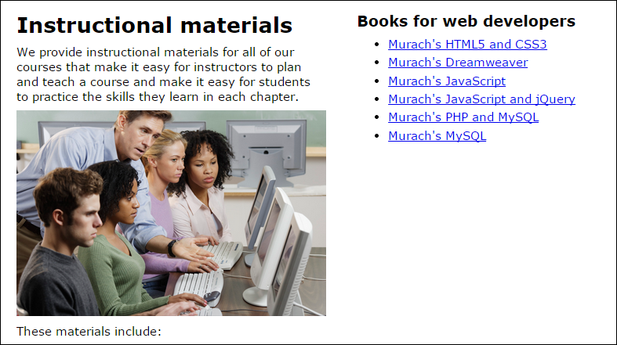
A scalable image in a fluid layout

Slide 20
The HTML for the image
<img src="images/students.jpg"
alt="Instructor with students">
The CSS for the image
section img {
max-width: 100%;
margin-bottom: .5em;
}
CSS that limits the width of the image
section img {
width: 100%;
max-width: 400px;
margin-bottom: .5em;
}

Slide 21
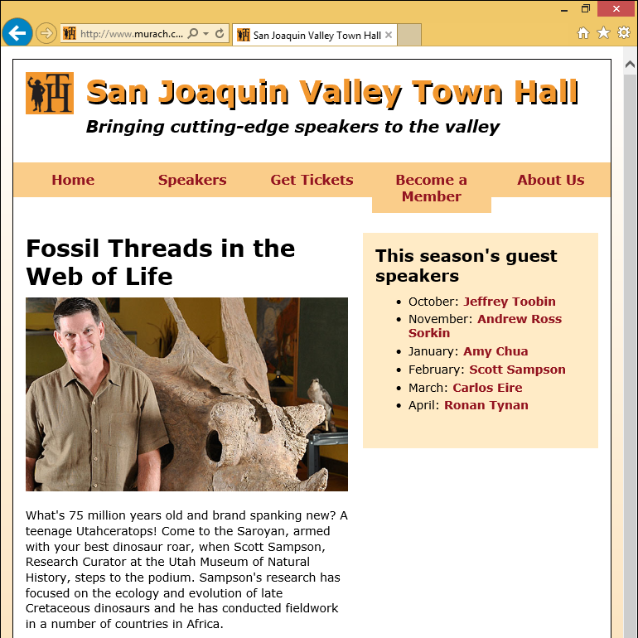
A page with a fluid layout

Slide 22
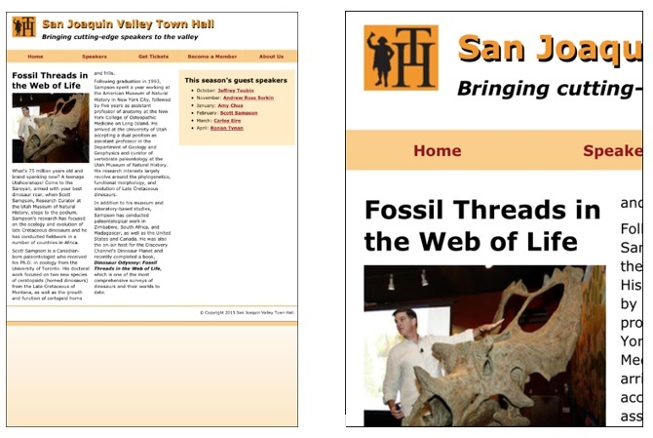
A web page on a mobile device without and with a meta viewport element

Slide 23
Content properties for viewport metadata
width
height
initial-scale
minimum-scale
maximum-scale
user-scalable
A meta element that sets viewport properties
<meta name="viewport"
content="width=device-width, initial-scale=1">

Slide 24
Common properties for the screen media type
width
height
device-width
device-height
orientation

Slide 25
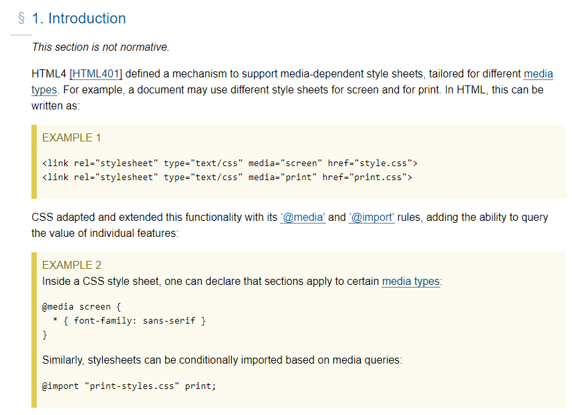
Media Queries
https://www.w3.org/TR/mediaqueries-4/

Slide 26
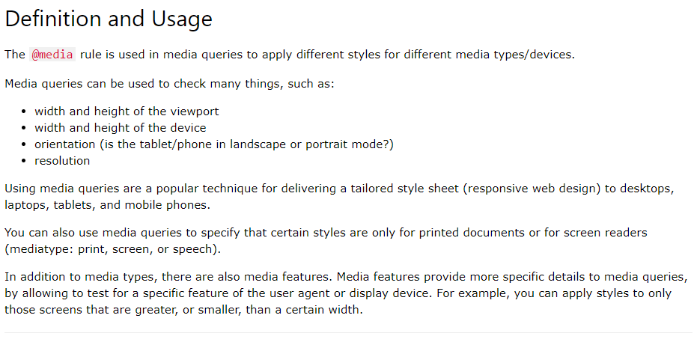
Media Queries
https://www.w3schools.com/cssref/css3_pr_mediaquery.asp

Slide 27
Typical media queries
Checks that the viewport width is 767 pixels or less
@media only screen and (max-width: 767px) {...}
Checks that the viewport width is between 480 and 767 pixels
@media only screen and (min-width: 480px)
and (max-width: 767px) {...}

Slide 28
Media queries for a desktop-first design
/* tablet landscape and desktop layout (960px or more) */ ...tablet landscape and desktop styles go here
/* tablet portrait layout (768px to 959px) */
@media only screen and (max-width: 959px) {
...tablet portrait styles go here }
/* mobile landscape layout (480px to 767px) */
@media only screen and (max-width: 767px) {
...mobile landscape styles go here }
/* mobile portrait layout (479px or less) */
@media only screen and (max-width: 479px) {
...mobile portrait styles go here }

Slide 29
Media queries for a mobile-first design
/* mobile portrait layout (479px or less) */
...mobile portrait styles go here
/* mobile landscape layout (480px to 767px) */
@media only screen and (min-width: 480px) {
...mobile landscape styles go here
}
/* tablet portrait layout (768px to 959px) */
@media only screen and (min-width: 768px) {
...tablet portrait styles go here
}
/* tablet landscape and desktop layout (960px or more) */
@media only screen and (min-width: 960px) {
...tablet landscape and desktop styles go here
}

Slide 30
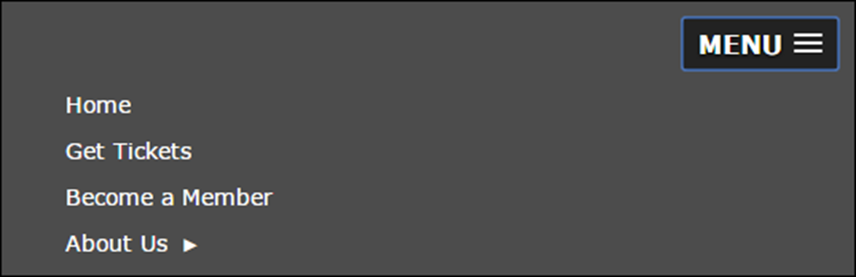
A multi-tier menu that uses SlickNav
Code for the SlickNav plugin in the head element
<link rel="stylesheet" href="styles/slicknav.css">
<script src="https://code.jquery.com/jquery-3.2.1.min.js">
</script>
<script src="js/jquery.slicknav.min.js"></script>
<script type="text/javascript">
$(function() {
$('#nav_menu').slicknav({prependTo:"#mobile_menu"});
});
</script>
Get the newest version of jQuery from https://code.jquery.com/

Slide 31
HTML for the SlickNav and navigation menus
<nav id="mobile_menu"></nav>
<nav id="nav_menu">
<ul>
<li><a href="index.html">Home</a></li>
.
.
</ul>
</nav>
CSS for the SlickNav menu
/* hide the mobile menu */
#mobile_menu { display: none; }
.
.
/* display the mobile menu */
#mobile_menu { display: block; }

Slide 33
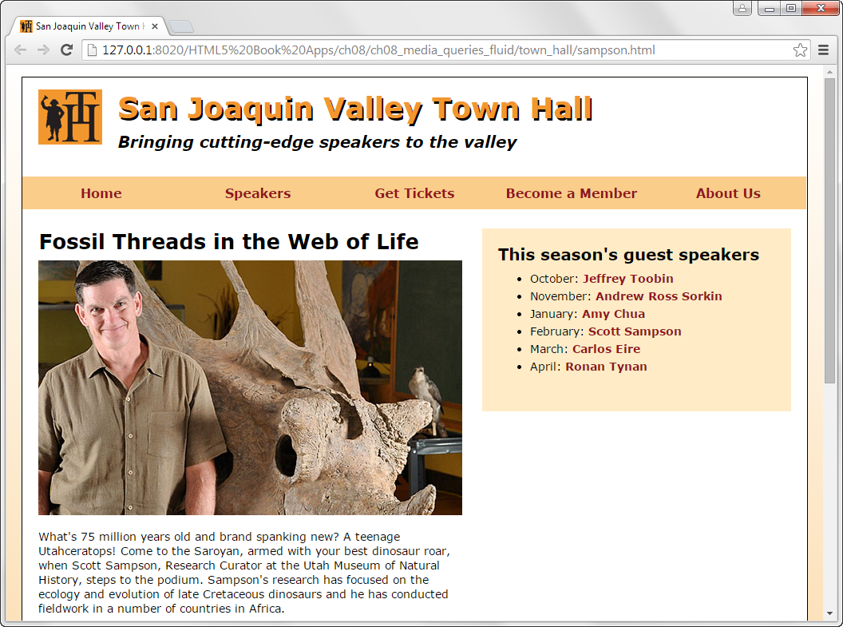
A speaker page in desktop layout

Slide 34
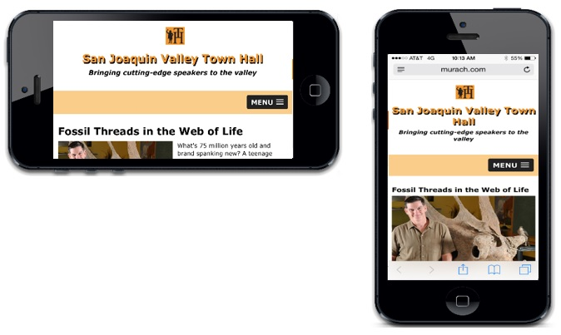
A speaker page in mobile layout

Slide 35
HTML for the main structural elements
<header>...</header>
<nav id="mobile_menu"></nav>
<nav id="nav_menu">
<ul>
<li><a href="index.html">Home</a></li>
...
</ul>
</nav>
<main>
<article>
<h1>Fossil Threads in the Web of Life</h1>
<img src="images/sampson.jpg" alt="Scott Sampson">
<p>What's 75 million years old and brand ... </p>
</article>
<aside>
<h2>This season's guest speakers</h2>
<nav>...</nav>
</aside>
</main>
<footer>
<p>&copy; Copyright 2018 San Joaquin Valley Town Hall.</p>
</footer>

Slide 36
Some of the CSS for the page (part 1)
/* standard 960 and above */ body {
font-family: Verdana, Arial, Helvetica, sans-serif;
font-size: 100%;
width: 96%; /* changed from 990 pixels */
max-width: 1200px; /* maximum width of page */
...
}
section, article, aside, h1, h2, h3, p {
margin: 0;
padding: 0;
}
section, article, aside { margin-bottom: 1em; }
p { font-size: .875em; ... } /* 14 ÷ 16 */
header { width: 100%; ... } /* full width of body */
header h2 {
font-size: 2.25em; /* 36 ÷ 16 */
margin-left: 12.12121%; /* 120 ÷ 990 x 100 */
... }

Slide 37
Some of the CSS (part 2)
header img {
width: 8.0808%; /* 80 ÷ 990 x 100 */
max-width: 80px; /* native size */
min-width: 40px; /* minimum size */
float: left;
margin-left: 2.0202%; /* 20 ÷ 990 x 100 */
}
#nav_menu ul { width: 100%; ... } /* full width of body */
#nav_menu ul li { width: 20%; ... } /* 198 ÷ 990 x 100 */
}
article {
width: 54.0404%; /* 535 ÷ 990 x 100 */
float: left;
margin-left: 2.0202%; /* 20 ÷ 990 x 100 */
padding: 1.5em 2.52525% 0 0; /* 25 ÷ 990 x 100 */
}
article h1 { font-size: 1.625em; ... /* 26 ÷ 16 */
article img { max-width: 100%; ... }

Slide 38
Some of the CSS (part 3)
aside {
width: 35.35353%; /* 350 ÷ 990 x 100 */
float: left;
padding: 2.0202%; /* 20 ÷ 990 x 100 */
background-color: #ffebc6;
margin: 1.5em 2.0202% 0 0; /* 20 ÷ 990 x 100 */
}
aside h2 { font-size: 1.25em; ... } /* 20 ÷ 16 */
aside h3 { font-size: 1em; } /* base font size */
aside li { font-size: .875em; ... } /* 14 ÷ 16 */
/* hide the mobile menu initially */
#mobile_menu {
display: none;
}

Slide 39
Some of the CSS (part 4)
/* tablet portrait to standard 960 */
@media only screen and (max-width: 959px) {
#nav_menu ul li a { font-size: .875em; } /* 14 ÷ 16 */
section h1, article h1 { font-size: 1.5em; }
/* 24 ÷ 16 */
section h2, aside h2 { font-size: 1.125em; }
/* 18 ÷ 16 */
}

Slide 40
Some of the CSS (part 5)
/* mobile landscape to tablet portrait */
@media only screen and (max-width: 767px) {
#nav_menu { display: none; }
#mobile_menu { display: block; }
.slicknav_menu {
background-color: #facd8a !important; }
body {
width: 100%; /* full width of screen */
margin: 0; /* no margins */
border: none; /* no border */
}
header, footer p { text-align: center; }
footer p { margin-right: 0; }
header h2 {
font-size: 1.625em; /* 26 ÷ 16 */
margin: .4em 0 .25em 0;
}
header h3 {
font-size: 1em; /* base font size */
margin-left: 0;
}

Slide 41
Some of the CSS (part 6)
header img { float: none; }
article {
width: 95.9596% /* 100 - padding */
float: none;
margin-right: 2.0202%; /* 20 ÷ 990 x 100 */
padding-right: 0;
}
article img {
float: left;
width: 50%;
margin-right: 2%;
}
aside {
width: 91.9192%; /* 100 - padding and margins */
float: none;
margin: 0 2.0202% 2.0202% 2.0202%;
/* 20 ÷ 990 x 100 */
}
}

Slide 42
Some of the CSS (part 7)
/* mobile portrait to mobile landscape */
@media only screen and (max-width: 479px) {
header h2 { font-size: 1.375em; } /* 22 ÷ 16 */
header h3 { font-size: .8125em; } /* 13 ÷ 16 */
p { font-size: .875em; } /* 14 ÷ 16 */
article h1, aside h2 {
font-size: 1em; } /* base font size */
aside li { font-size: .875em; } /* 14 ÷ 16 */
}
article img {
float: none;
width: 100%;
margin-right: 0;
}
aside h3 { font-size: .9375em; } /* 15 ÷ 16 */
footer p { font-size: .6875em; } /* 11 ÷ 16 */
}

Slide 43
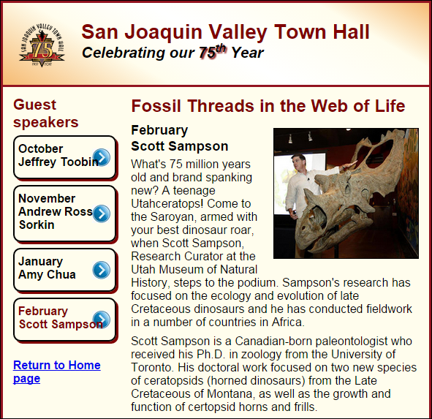
Short 8-1 Create a fluid design

Slide 44
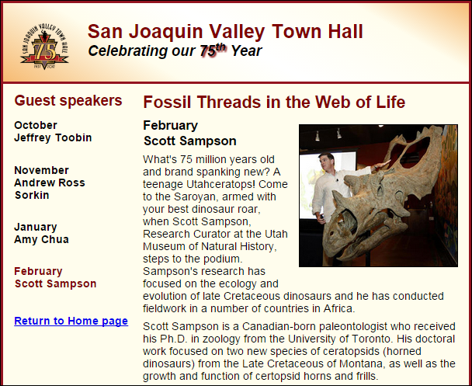
Short 8-2 Add a media query

Slide 45
Objectives
Applied
Given an HTML document for the desktop that uses a fixed layout, convert it so it uses fluid widths, scalable images, and fonts that are inherited by child elements.
Given an HTML document for the desktop that uses a fluid layout, add media queries that change the appearance of the page depending on the size of the screen where it’s displayed.
Given an HTML document with a navigation menu that uses media queries, use the SlickNav plugin to replace the navigation menu on smaller screen sizes.
Use the browser developer tools to test your responsive designs.
Knowledge
Describe the three components of a Responsive Web Design.
Describe three basic ways that you can test a responsive design.

Slide 46
Objectives (cont.)
Explain how fluid layouts compare to fixed layouts.
Explain why you should use relative font sizes with a responsive design.
Describe the use of the meta element for setting the viewport on mobile devices.
Describe the basic syntax of a media query.
Describe two standard approaches for developing the media queries for a responsive design.
Explain why you might want to use a SlickNav menu when developing a responsive design.

Slide 47
Assignments
Reading assignments on Perusall
Homework and Labs on InsideRanken

